Slide 2
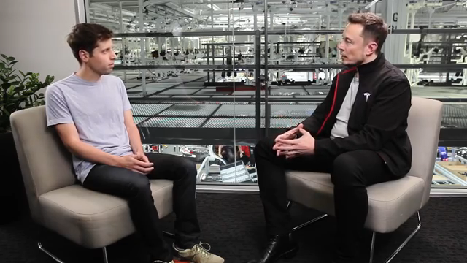

Slide 3
Who is this and what is he talking about?

Slide 4
Brain-Computer Interface (BCI)
Soumya Kundu and Christopher Oldham

Slide 5
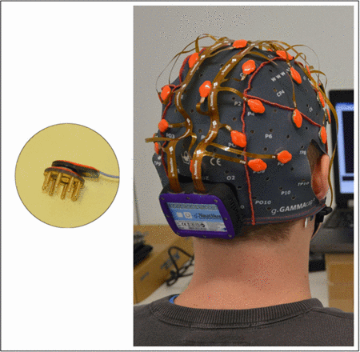
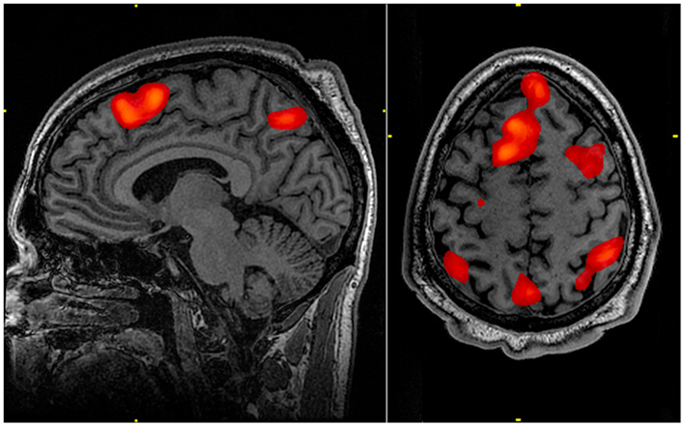
BCI?
A brain-computer interface (BCI) is a device that provides the brain with a new, non-muscular communication and control channel
fMRI & EEG

Slide 6


Slide 7
What are some current applications of BCI?

Slide 8
Current Applications of BCI
Mouse moving, writing emails & doing crossword puzzles
Wheelchair control
Controlling household appliances
Mechanical arm control

Slide 9
What problems might we have with our current BCI technology?

Slide 10
Current issues with BCI
Underdeveloped
Consent

Slide 11
What could we do in the future?

Slide 12
Future applications of BCI
Mechanical leg control & exoskeletons
Dream recording
Video games
Brain prosthesis & augmentation

Slide 13
How bad can it get?

Slide 14
Future issues with BCI
Hackable Brains
Massive privacy concerns, thought policing
Overdependence
Agency

Slide 15
Should we pursue BCI technology?
To what extent?

